Slide 1
Data Analysis for Future Energy Consumption
Name: Dinesh kumar. R
College: St.Peter’s College of Engineering & Technology
Department: Civil Engineering

Slide 2
Introduction
Energy consumption forecasting is vital for utilities, businesses, and policymakers.
Accurate forecasts inform decisions on energy production, distribution, and consumption.
Historical data analysis helps anticipate future energy needs and optimize resource allocation.

Slide 3
Importance of Energy Consumption Forecasting
Forecasting guides power generation, budgeting, resource planning, and policy development.
Reliable forecasts ensure adequate supply, prevent blackouts, and support sustainability initiatives.

Slide 4
System Approach
System Requirements:
Hardware:
CPU: intel core i5 9th gen
RAM: 4GB
Data Sources: Energy data comes from smart meters, IoT devices, utility bills, and monitoring systems
Data Storage: cloud storage solutions, 1GB storage max
Software Environment: Python or R, as well as specific software packages for statistical analysis

Slide 5
Library Approach
Library Requirements:
Pandas: Pandas is a powerful Python library for data manipulation and analysis.
NumPy: NumPy is a fundamental package for scientific computing with Python.
Matplotlib: Matplotlib is a popular Python library for creating static, interactive, and animated visualizations.

Slide 6
Algorithm & Deployment
Data Cleaning and Preprocessing: Algorithms are used to clean and preprocess rainfall data by handling missing values, removing outliers, and standardizing formats.
Exploratory Data Analysis (EDA): Visualization algorithms, statistical methods, and machine learning techniques are often employed for EDA.

Slide 7
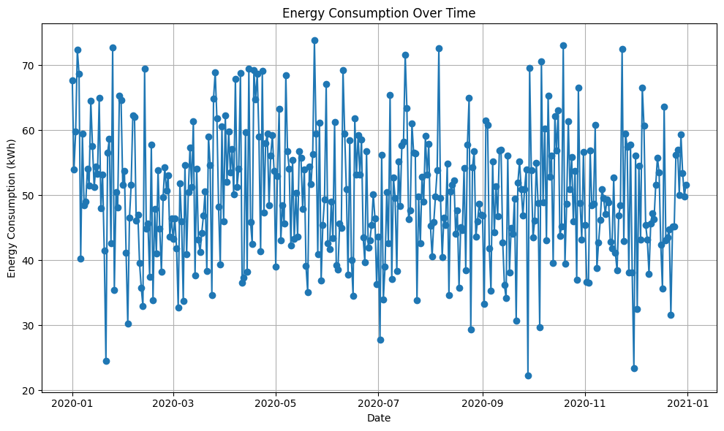
Result

Slide 8
Conclusion:
Accurate forecasts enable utilities, businesses, and policymakers to anticipate energy needs, optimize resource allocation, and mitigate risks associated with energy shortages or overages.
Through continuous improvement and refinement of forecasting models, organizations can ensure a sustainable and resilient energy future.

Slide 9
Thanks You

